Slide 1


Presentation by
Douglas Heller, Director of Insurance Consumer Federation of America
to the
Insurance Rate Review Ad Hoc Committee
September 29, 2025
www.ConsumerFed.org

Slide 2







Sources of Data for Today’s Presentation

Slide 3
The “Float” and the Insurance Cycle

Slide 4
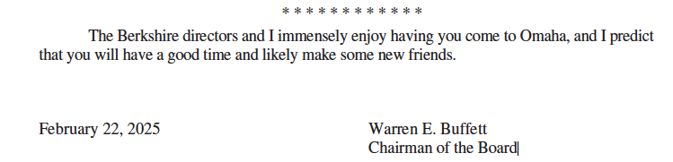
BERKSHIRE HATHAWAY INC.
To the Shareholders of Berkshire Hathaway Inc.:
2025 – p. 9-10
The industry follows a financial model that is rare – very rare – among giant businesses…. this “money-up-front, loss-payments-later” model has allowed Berkshire to invest large sums (“float”)
…. Over the past two decades, our insurance business has generated $32 billion of after-tax profits from underwriting… Meanwhile, our float has grown from $46 billion to $171 billion.
2005 – p. 6
When an insurer earns an underwriting profit – as has been the case at Berkshire in about half of the 39 years we have been in the insurance business – float is better than free. In such years, we are actually paid for holding other people’s money. …In aggregate, the property-casualty industry almost invariably operates at an underwriting loss.

Slide 5
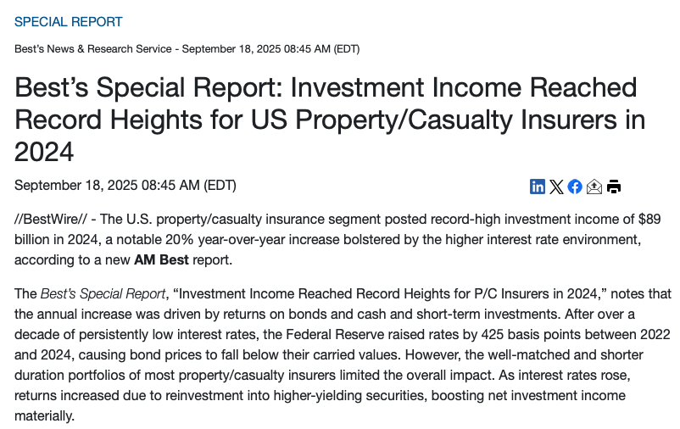


Slide 6
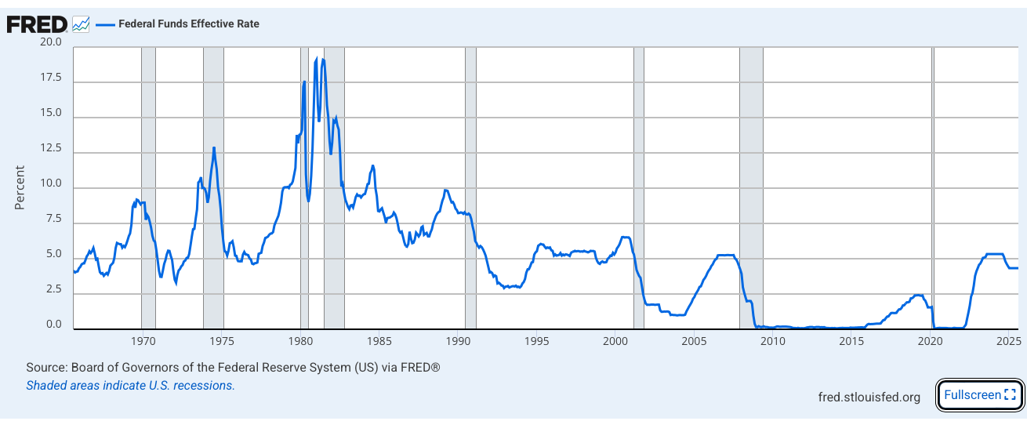
Insurance Cycle: Rate Hikes, Restrictions & Calls for Tort Reform Follow The Fed
Insurance “Crisis” Begins
Insurance “Crisis” Begins
Insurance “Crisis” Begins
Insurance “Crisis” Begins

Slide 7
Homeowners Insurance

Slide 8
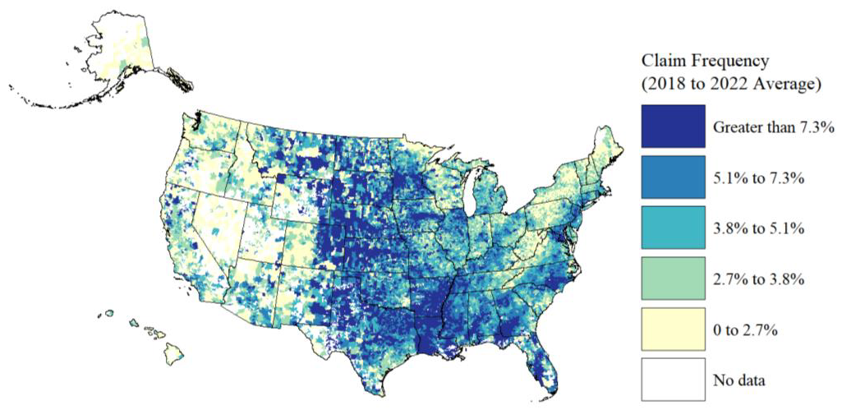
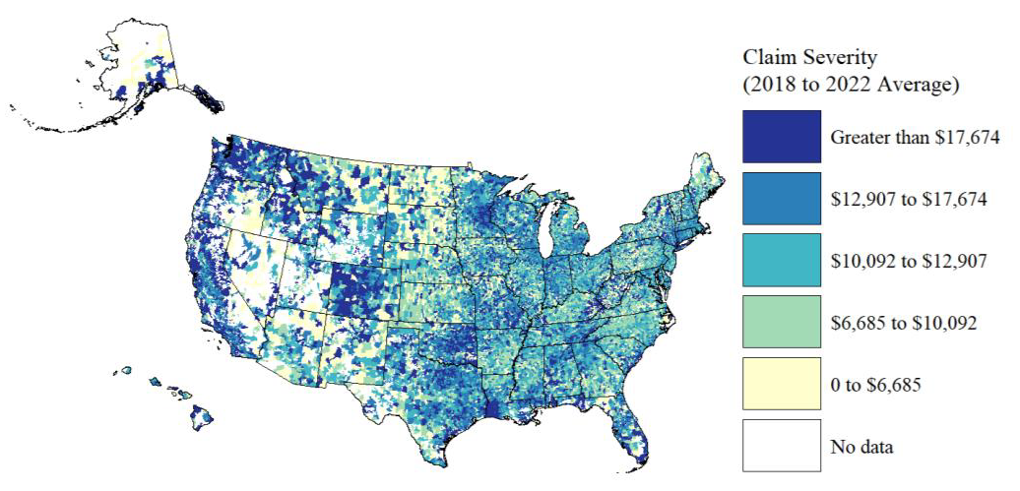
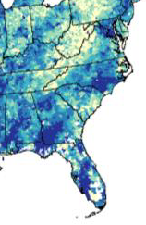
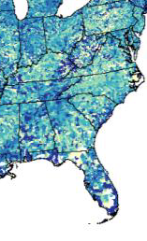
National PCMI Data Claim Frequency (2018-2022 Average) by ZIP Code
National PCMI Data Claim Severity (2018-2022 Average) by ZIP Code
Source:

Slide 9
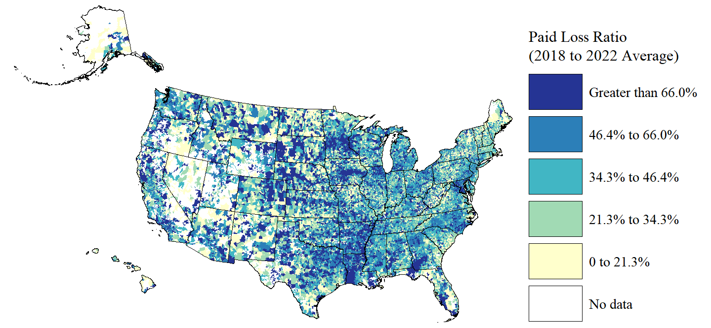
National PCMI Data Paid Loss Ratios (2018-2022 Average) by ZIP Code
Source:

Slide 10
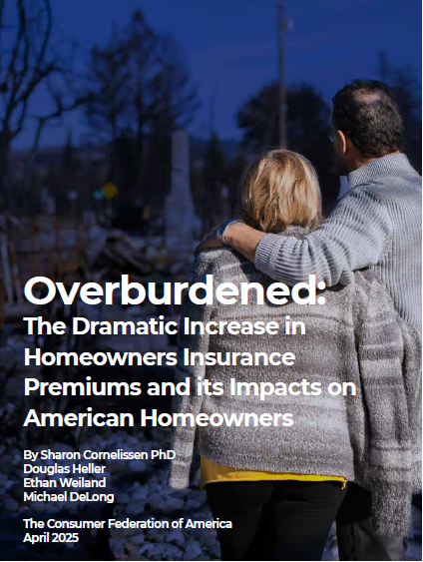
Premium Hikes
Average home insurance premiums for a typical South Carolina homeowner increased by 17.4% from 2021-2024.
In 2021, the annual home insurance premium for a typical homeowner with a $350,000 replacement value policy was $2,535. In 2024, it rose to $2,977.
Premiums increased by 14.4% in rural areas and 18.3% in urban and suburban areas.
+$442

Slide 11
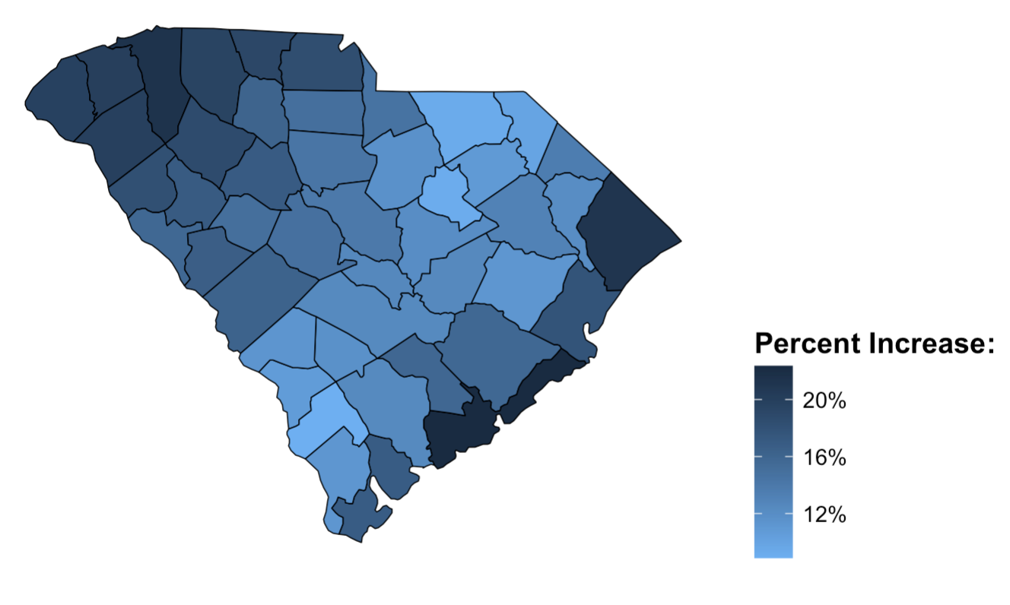
% Increase in Home Insurance Premium by County, 2021 to 2024

Slide 12
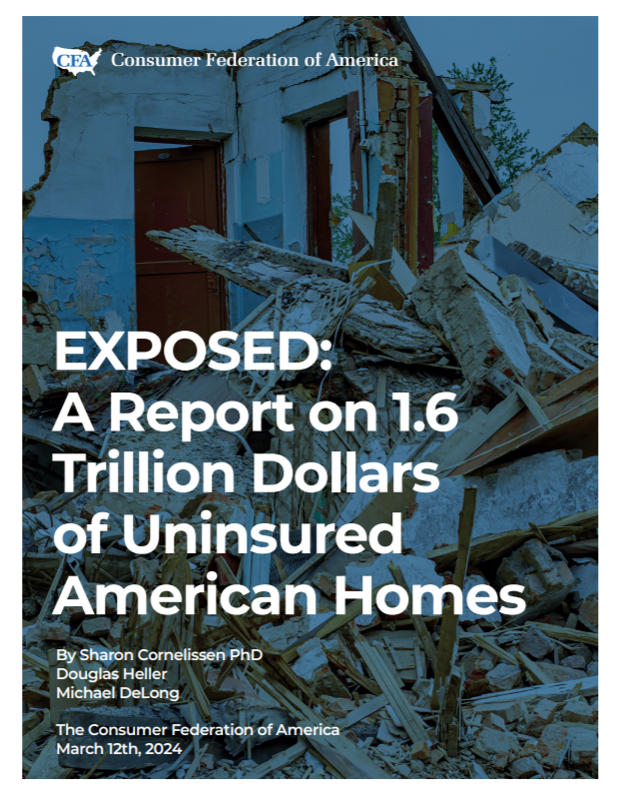
Uninsured Homes
Nationally, 7.4% (or 6.1 million homeowners) are uninsured resulting in $1.6 trillion in property value being at risk
In South Carolina, 9% of homeowners are uninsured
Low-income homeowners, non-white homeowners, owners of manufactured homes, homeowners with inherited homes, and homeowners in rural areas are most at risk of being uninsured

Slide 13
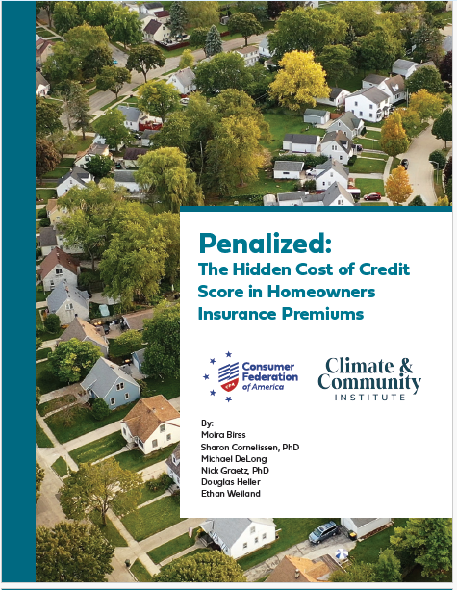
Credit Score Penalty
+116%
Insurers charge South Carolina homeowners huge penalties for having less than excellent credit scores.
+$898
per year
+45%
+$2,270
per year
Penalty for Average Credit
Penalty for Below Fair Credit

Slide 14
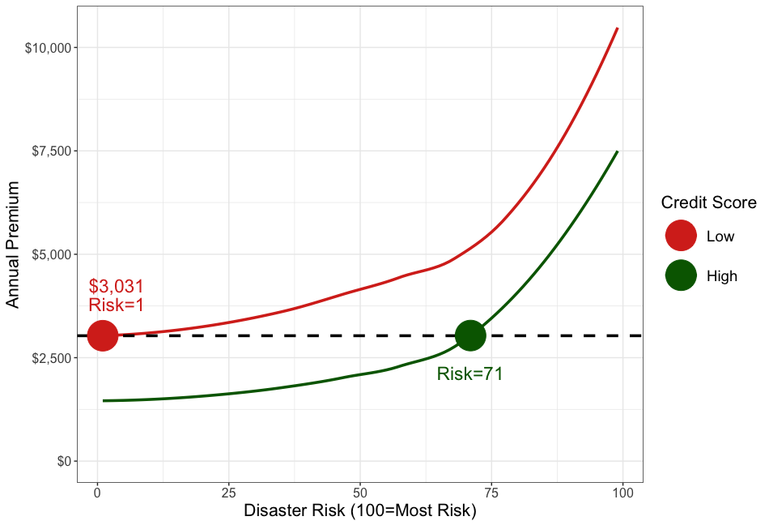
It Is Often More Expensive to Have Poor Credit
Than to Live in an Area With High Disaster Risk
Interpretation: On average, a homeowner with a low credit score in the least risky part of the county (1st percentile of disaster risk) pays the same premium as a homeowner with a high credit score in a much riskier area (71st percentile of disaster risk)
Implications:
Low credit score homeowners effectively subsidize premiums of high credit score homeowners in risky areas
Calls into question use of price for signaling disaster risk

Slide 15
Auto Insurance

Slide 16
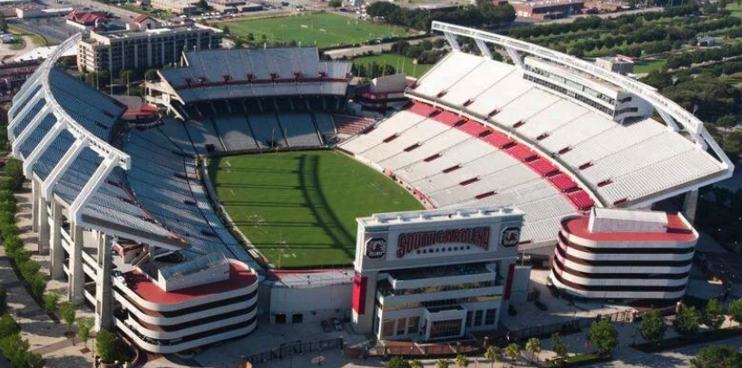
Auto Insurance Pricing in South Carolina
Meet Our Driver:
35-year-old living in Columbia (29203)
2015 Ford Fusion
20-mile daily round trip commute
Buys the minimum required auto insurance coverage
Perfect driving record – no tickets or accidents
THESE FACTORS ARE THE SAME FOR EVERY QUOTE

Slide 17

Married Male Investment Banker with MBA
Homeowner, Currently Insured & Pays in Full
$256

Slide 18
Married Single Male Investment Banker with MBA
Homeowner, Currently Insured & Pays in Full
$271

Slide 19
Married Single Male Female Investment Banker with MBA
Homeowner, Currently Insured & Pays in Full
$286

Slide 20
Married Single Male Female Investment Banker with MBA
Supermarket Clerk with HS Diploma
Homeowner, Currently Insured & Pays in Full
$313

Slide 21
Married Single Male Female Investment Banker with MBA
Supermarket Clerk with HS Diploma
Homeowner Renter, Currently Insured & Pays in Full
$329

Slide 22
Married Single Male Female Investment Banker with MBA
Supermarket Clerk with HS Diploma
Homeowner Renter, Currently Insured & Pays in Full Installments
$352

Slide 23
Married Single Male Female Investment Banker with MBA
Supermarket Clerk with HS Diploma
Homeowner Renter, Currently Insured Uninsured
& Pays in Full Installments
$580

Slide 24


Same Car, Same Location, Same Commute,
Same Driving Record…Different Price
+127%

Slide 25
Credit Scores Are a Chief Driver of Car Insurance Premiums
Safe Driver with… | National Average Premium by Credit Score | South Carolina Average Premium by Credit Score
Excellent Credit | $470 | $519
Fair Credit | $701 | $775
Poor Credit | $1,012 | $1,103
112% Penalty
Data Source:

Slide 26
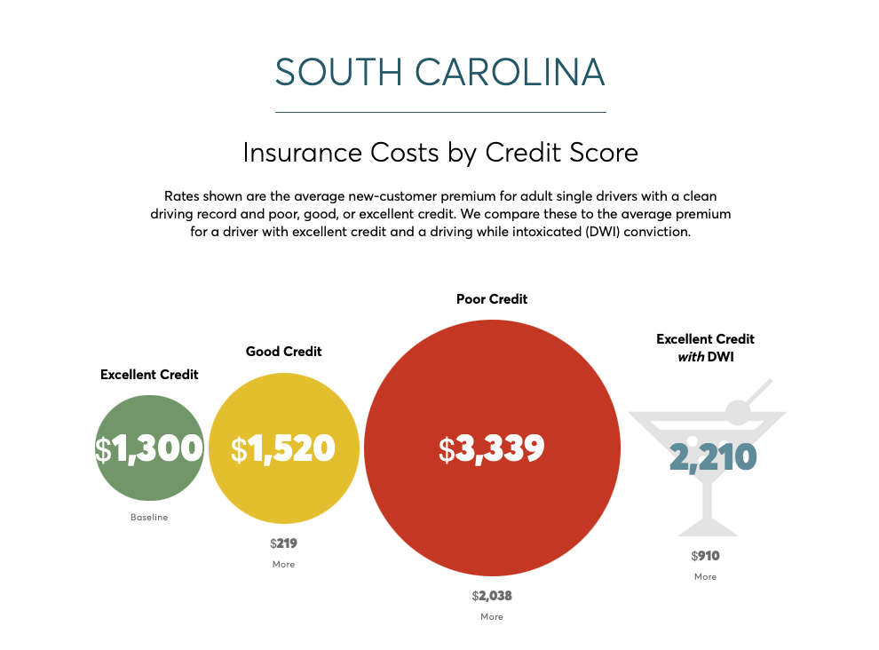
Source:

Slide 27
Source:

Slide 28
Source:

Slide 29
Source:

Slide 30
Industry Profitability

Slide 31
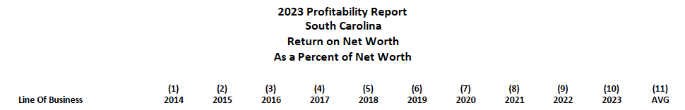
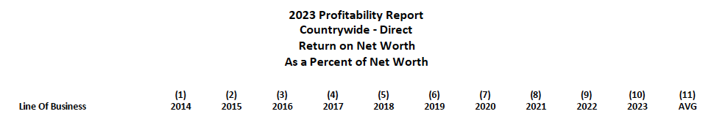
2014-2023 P&C Profits in S.C. Beats Nation
Source:

Slide 32
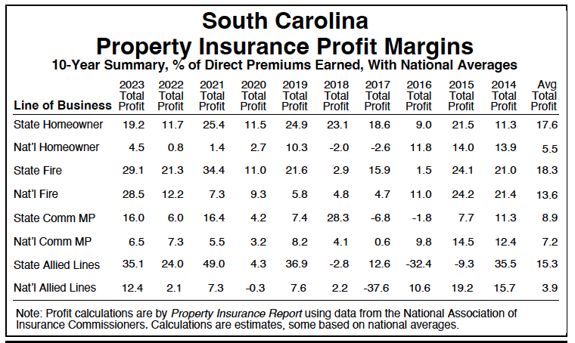
2014-2023 Property Insurance Profit in S.C. Beats Nation

Slide 33

2024: A Banner Year for the P&C Sector
Property/Casualty Net Income 2024: $169.3 Billion
Stockholder Dividends in 2024: $85.9 Billion

Slide 34
2024: Insurers with Business in S.C. Return Better Results
Average National Net Income per Insurer
Homeowners Insurance
Companies Selling in S.C.: 6.9%
All Companies Nationwide: 5.2%
Auto Insurance
Companies Selling in S.C.: 10.5%
All Companies Nationwide: 5.6%
All P&C Insurance
Companies Selling in S.C.: 10.4%
All Companies Nationwide: 8.5%

Slide 35





2025: The Profits Keep Rolling In
Quarterly Net Income: $3.2 billion
Allstate Reports Second Quarter 2025 Results
“Revenues increased to $16.6 billion and net income was $2.1 billion for the quarter.”
Travelers Reports Excellent Second Quarter and Year-to-Date Results
Second quarter net income of $1.509 billion…and Return on Equity of 20.9%

Slide 36
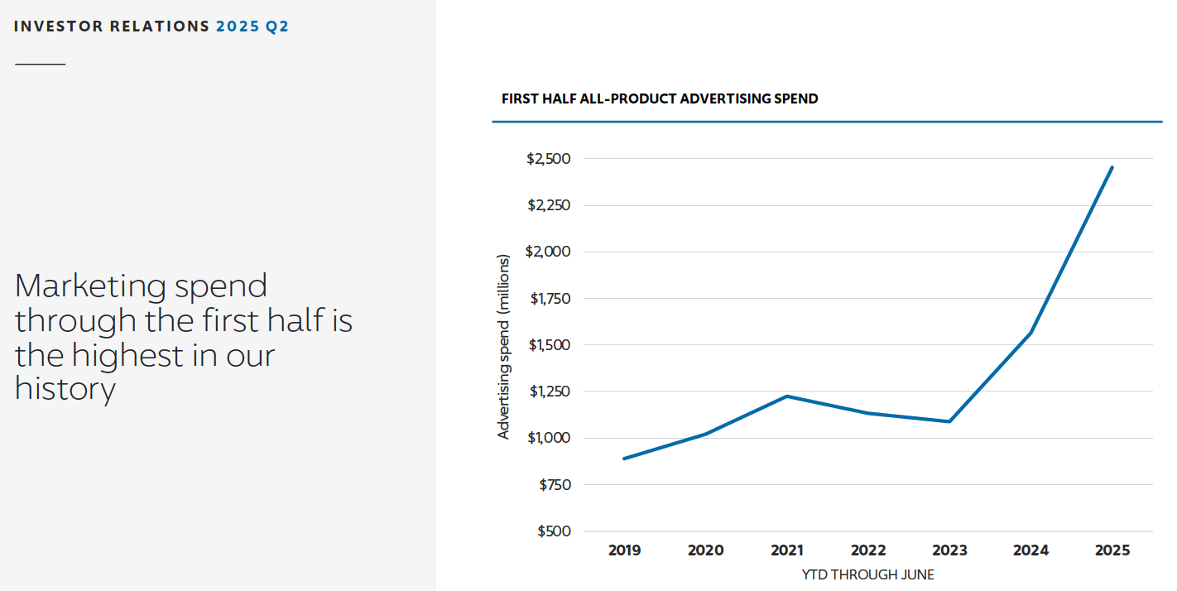
One Company, Six Months, $2.5 Billion Advertising Spend

Slide 37

douglasheller@consumerfed.org

